Slide 1


OSHANA REGIONAL COUNCIL
PROCUREMENT TRAINING
PROCUREMENT INTEGRITY
18 -19 SEPTEMBER 2024
BY: MATATIAS MOSES
“GROWTH IS THE ONLY GUARANTEE FOR A BETTER TOMORROW”

Slide 2
PRESENTATION HIGHLIGHT:
    Integrity
    Commitment for Procurement Integrity
    Guiding Principles of Ethical Conduct
    Corruption
    Levels of Corruption
    Probity
    Discussions & Questions

Slide 3
INTEGRITY
What is Integrity?
Integrity refers to “honesty” or “trustworthiness” in the discharge of official duties. Integrity also includes: impartiality; probity and fairness
Commitment for Procurement Integrity
Public Entity
Public Officials
Bidders, Suppliers, Contractors
Consultants

Slide 4
GUIDING PRINCIPLES FOR ETHICAL CONDUCT
Rule of law
Professionalism
Avoidance of conflict of interest
Transparent, fair and efficient procurement processes
Accountability, control measures and deterrents
Avoiding Corruption; Fraudulent; Gifts and Bribery
Avoiding of artificial division and manipulation
Undue influence
Confidentiality
Supplier relationship
Culture

Slide 5
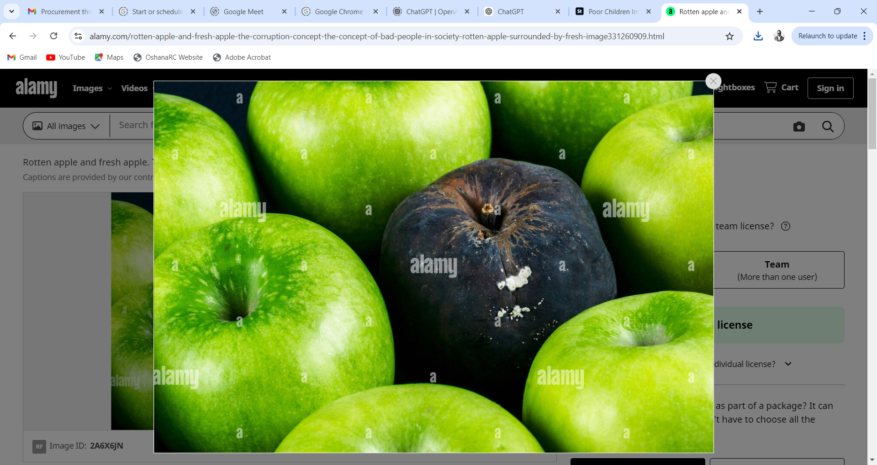
CORRUPTION…1
  In your view,
  What is Corruption & What corrupts a Man /Women?
  3. What happens to an Official who violates Section 66 (1),(2) & (3)
  Section 66(3): A staff member who “commits an offence is liable to a fine not exceeding N$1,000,000 or to imprisonment for a period not exceeding 10 years, or to both such fine and such imprisonment.

Slide 6
CORRUPTION…2
Corruption
  Corruption:
  Dishonestly obtaining an advantage, avoiding and obligation or causing a loss to public property or various means during procurement process by public servants, contractors or any other person involved in the procurement;
  Collusion and manipulation between employees and the bidding companies leading to bribes, brown envelopes and kickbacks;
  Leaking bid information leading to unfair advantages;
  Rigged bid specifications purposefully to broaden scope;
  Tenderprenurism:
Enrichment through corrupting the award of government contracts
Often based on personal connections and corrupt relationship
Add costs to process but no value (inflated prices)
Tender-preneurism

Slide 7
LEVELS OF CORRUPTION
1st level - Initial phase and bid preparation
2nd level - Prior to issue of bids
3rd level - Prior to closing date for bids
4th level - Receipt and opening of bid responses
5th level - During evaluation of bid responses
6th level - After selection of the preferred bidder
7th level - Assistance throughout the bidding process

Slide 8
Levels of Corruption:
*Source: PwC Global Economic Crime Survey 2016
True /
False
  Corruption cannot happen if there are no internal players!

Slide 9
PROBITY
Probity is a risk management process designed to ensure procedural integrity in supply chain. It is a way of ensuring that the bidding process is fair and certified correct during the bidding and award process rather than after the process.
Think about the key principles governing public procurement & perceived risk. How will you best eliminate the risk of corruption at various stages of procurement?

Slide 10
Probity…2
Process
Risks
Action
1. Initial phase and bid preparation | Collusion with a service provider Manipulation of bid specifications | Review bid specifications and business case Consultations with project owners & stakeholders Review procurement plans
2. Prior to issue of bids | Leaking of bid information Limited distribution Evaluation model not fair, reasonable & transparent | Review communication protocol Consider evaluation model
3. Prior to closing date for bids | Unfair advantage to bidders through supply of information Unrealistic deadlines | Oversee communication protocol Oversee briefing sessions

Slide 11
Probity…2
Process
Risks
Action
4. Receipt and opening of bid responses | Accepting late bids Leaking of confidential bid information | Review process of receipt of bids Attend bid opening process Ensure storing & safekeeping of bids
5. During evaluation of bid responses | Key individuals influencing the process Conflicts of interest Unfair disqualification Inconsistent evaluation of bids not in line with the BD or the Act Recommendation to PC not comprehensive | Declaration of interest and confidentiality Background checks Constitution of committees Review mandatory requirements Review conduct of evaluation members Ensure record-keeping is appropriate

Slide 12
Probity…2
Process
Risks
Action
6. After selection of preferred bidder | Freedom to negotiator Contract terms different to bid specifications Back to back agreements Change orders Inaccurate disclosure | Oversee negotiations with preferred bidder Compare contractual arrangements to bid recommendation Consider scope for variation
7. Assistance throughout the tender process | Ongoing risk of litigation Procedural reviews | Assess process for compliance with policies and legislation Perform milestone reviews Review of financial delegations & internal authorisations

Slide 13
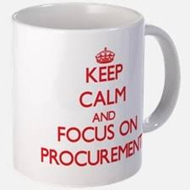
CONCLUSION
THANK YOU! ASANTE SANA!

